Slide 1

CISC 250 – Business Telecomm Networks
Network Architecture
– A Layered Model
Dr. Jinwei Cao
Dept. of ACCT & MIS
University of Delaware

Slide 2
Today’s Outline
Needs For A Layered Model
Protocols and Network Architecture
Standards
OSI
TCP/IP
Hybrid

Slide 3
You have a gift …
You need to send it to ______ …

Slide 4

You
_____

Slide 5
A Layered Model
Task broken into subtasks
Implemented separately in layers in stack
Each layer provides a service to the layer above
Each layer hides details of how the service is provided from the layer above
Functions needed in both systems
The Nth layer on one machine “talks to” or interacts with the Nth layer on another machine

Slide 6
Protocols
Conventions and rules governing this interaction are specified by the Layer N Protocol
A protocol is an agreement about how communications are to proceed
Without a protocol communication can be difficult or even impossible
E.g. Telephone conversation, Postal addresses

Slide 7
Division of Protocols
Connection-Oriented
a logical connection be established between two devices before transferring data
a circuit is not a prerequisite for a connection
Circuit-switched => connection-oriented, but not all connection-oriented => circuit switching
Connectionless
do not establish a connection between devices

Slide 8
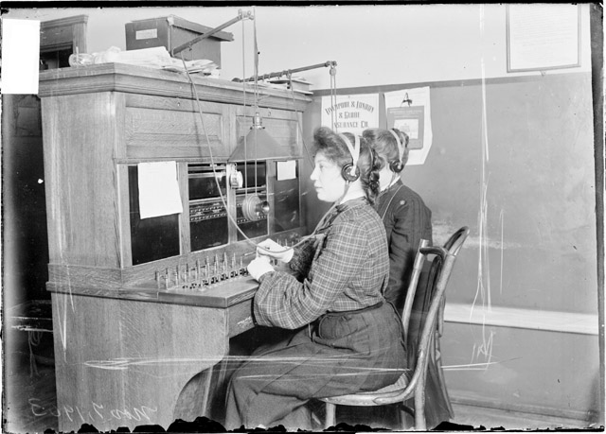
Circuit Switching

Slide 9
Packet Switching
1. Break message into
Smaller packets
(or frames)
Original Message
Packet
Switch
A
B
C
Computer X
Packet
Switching
Decision
Computer Y
F
D
E
2. Route packets individually;
Packet switches along the way
Make decisions about the packet

Slide 10
Packetizing
Packets (also known as):
Cells, frames, packets, block, data units
However, they are loosely used interchangeably!
Cell: is a 53-bytes packet used by ATM
Frame: is used in the data link layer
Packet: is used in the network layer
Examples:
Ethernet frame, Token ring frame
ATM cell

Slide 11
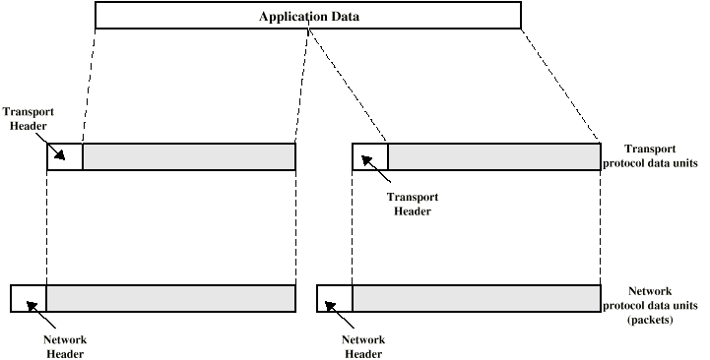
Encapsulation
Addition of Control Information to Data
Address Information
Error-detecting Code
Protocol Control
N-layer PDU (Protocol Data Unit) = Header + (N+1)-layer PDU + Trailer

Slide 12
Network Architecture
The set of protocols and layers together make up the Network Architecture
A Network Architecture Specification must provide enough information to allow implementation in hardware/software
Implementation specific details are not part of the architecture and should be irrelevant for inter-operation
With one protocol per layer we have a Protocol Stack

Slide 13
Standardized Network Architectures
Required for devices to communicate
Vendors have more marketable products
Customers can insist on standards based equipment
Two standards:
OSI Reference model
Never lived up to early promises
TCP/IP protocol suite
Most widely used
De facto

Slide 14
OSI Model
Open Systems Interconnection
Developed by the International Organization for Standardization (ISO)
Seven Layers
A Theoretical System Delivered Too Late!
TCP/IP Is the De Facto Standard

Slide 15
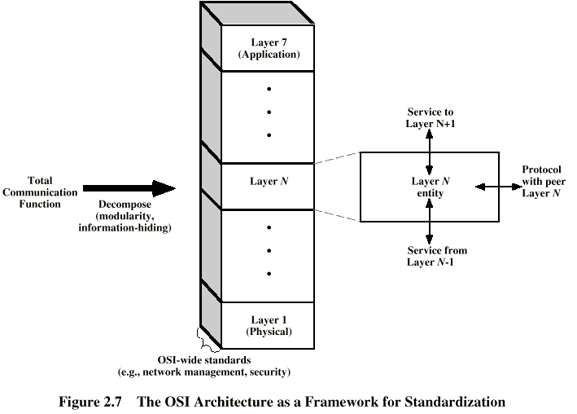
OSI Model

Slide 16

OSI Layers
Application -------- Acronyms
Presentation ------ Pointless
Session ------------ Students
Transport ---------- Teach
Network ------------ Not
Data Link ----------- Do
Physical ------------- Please

Slide 17
OSI Layers (1)
Physical
Physical Interface Between Devices
Mechanical – hardware, topology
Electrical - signaling
Data Link
Activating, Maintaining and Deactivating a Reliable Link – between local devices
Media access control
Error Detection and Control
Higher Layers May Assume Error Free Transmission

Slide 18
OSI Layers (2)
Network
Delivery of Information
logical addressing
routing
Fragmentation and assembly
Error handling
Not Needed on Direct Links
Transport
Reliability control between End Systems (hosts, computers)
In Sequence
In good flow
Error Free
No Losses
No Duplicates

Slide 19
OSI Layers (3)
Session
Control of Dialogues Between Processes
Establish, manage, and terminate dialogues
Presentation
Data Formats and Coding
Data Compression
Encryption
Application
Implement user required functionalities
Send letters, move files

Slide 20
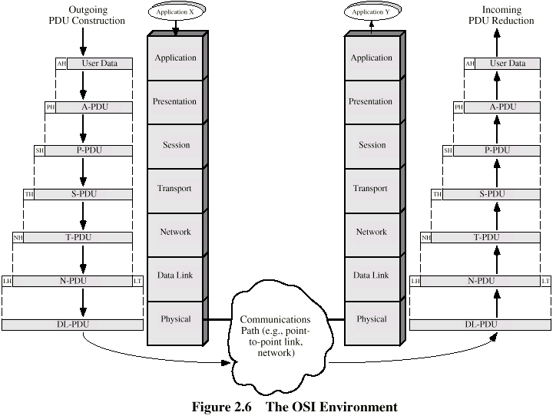
The OSI Environment
Video Demo

Slide 21
TCP/IP Model
TCP = Transmission Control Protocol
IP = Internet Protocol
TCP/IP is an Internet Model
This model has only 4-layers
It is simpler and more practical than the 7-layered OSI-Model
Created by the US Dept of Defense (DoD)

Slide 22

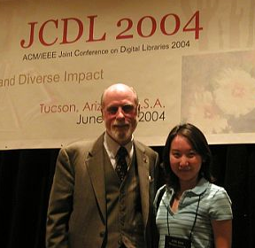

Father(s) of TCP/IP
Vint Cerf
Bob Khan

Slide 23
TCP/IP Model
Application Layer:
Combines all the application-related issues into 1-layer
Includes the Sessions/Presentation layers
Transport Layer:
Deals with the QoS and other issues like:
Reliability, flow control and error correction
Internet Layer:
Delivery
Routing
Network Interface Layer:
Ensures the physical links

Slide 24
TCP/IP, OSI, and TCP/IP-OSI Hybrid Architecture
TCP/IP
OSI
Hybrid TCP/IP-OSI
Application
Application
Application
Presentation
Session
Transport
Transport
Transport
Internet
Network
Internet
Network Interface
Data Link
Data Link
Physical
Physical

Slide 25
Message Communication in Hybrid TCP/IP-OSI
Application
Layer
HTTP Msg
Application
Layer
Transport
Layer
TCP Seg
Transport
Layer
Internet
Layer
IP Packet
Internet
Layer
Internet
Layer
Data Link
Layer
Ethernet
Frame
Data Link
Layer
Data Link
Layer
Data Link
Layer
Physical
Layer
Physical
Layer
Physical
Layer
Physical
Layer
Ethernet Switch
Router
Client PC
Server

Slide 26
Layer Design Issues
Most layers need:
Message segmentation and aggregation
Some form of Addressing to identify senders and receivers of messages
Multiplexing/Demultiplexing of multiple message streams to optimize channels
Flow control (fast sender vs. slow receiver)
Error controls (detection and correction)
A set of rules for data exchange
Routing of messages when there may be several physical paths

Slide 27

A protocol for
The class?
Your team communication?

